Slide 1
The Economic Crisis Impact on Industrial Relations National System in Turkey Policy Responses As Key Recovery Tools
tepav
Türkiye Ekonomi Politikaları Araştırma Vakfı
Sibel Güven
Sofia, 16th November 2012

Slide 2
Outline
Methodology
Framework of Industial Relations in Turkey
Current legislation and social dialogue mechanisms
Impact of the 2008 crisis on the Turkish economy and employment
Government policy responses to the crisis and its costs
Policy responses and social dialogue at three different levels
National level
Cross-sectoral level
Company level
Conclusion

Slide 3
Methodology
Desk research
Data from TurkStat, the Ministry of Work, Employment and Social Security, OECD
Face-to-face interviews with the stakeholders:
8 interviews with trade unions, employers’ associations, private companies and the government officials
National debate (Oct 16, 2012):
Consisted of all stakeholders

Slide 4
Development of an IR System in Turkey
1950s: The first well-established unions
1961 Constitution: A relatively more liberal environment
1980 military intervention: suppression of trade unions
constitution and trade union laws were changed
Trade union development suspended
Some trade unions were closed
Unions lost influence and informal employment increased
Source: OECD

Slide 5
Key statistics
Source: Ministry of Work, Employment and Social Security

Slide 6
Current legislative framework
Labour Code No. 4857, enacted in 2003
Trade Union Law for Public Servants, enacted in 2001 - grants union membership rights to public servants
New law “Law on Public Servants and Collective Agreement” on April 11, 2012 – gives collective bargaining rights but not the right to strike to public workers
Trade Unions Act (no. 2821), enacted in 1983 and Collective Labour Agreement, Strike and Lockout Act (no. 2822), adopted in 1983 just became ineffective (November 2012)
A comprehensive new law instead of no.2821 and 2822 was legislated: “Law on Trade Unions and Collective Bargaining”

Slide 7
Changes introduced so far by the new law on trade unions and collective bargaining
Amendments that are accepted so far:
Notary signature is no longer obligatory for becoming or leaving the membership of a trade union
Membership to a trade union will continue for another year if the worker becomes unemployed
Trade unions and confederations are permitted to open international representative offices
If a case is submitted to courts on grounds that the employment contract is terminated due to union membership reasons, the burden of proof will be on the employer
Lines of business (sectors) where workers can be represented by trade unions have been aggregated into 20 from 28
Minimum age to become a member of a trade union has been reduced from 16 to 15
Financial auditing of trade unions and confederations will be conducted by certified public accountants (CPA)
Aggreement on the remaining clauses reached and new law enacted at the beginning of November

Slide 8
Social Dialogue Partners
Public Sector
TİSK
TOBB
TÜSİAD
MÜSİAD
TİM
TESK
TÜRK-İŞ
DİSK
HAK-İŞ
MEMUR-SEN
TÜRKİYE KAMU-SEN
KESK
SOCIAL DIALOGUE
Employers’ organizations
Trade unions

Slide 9
Major employers’ organization
Professional associations*
Turkish Confederation of Tradesmen and Craftsmen (TESK)
13 occupational federations
82 unions of tradesmen and craftsmen chambers
Turkish Confederation of Employers’ Associations
(TİSK)
Union of Turkish Chambers of Agriculture (TZOB)
727 chambers of agriculture
22 Employers’ associations
Union of Chambers of Turkish Engineers and Architects
(TMMOB)
23 occupational chambers
* Professional associations which are active stakeholders of the industrial relations system in Turkey

Slide 10
Other associations that represent the private sector
The Union of Chambers and Commodity Exchanges of Turkey
(TOBB)
Turkish Industry and Businessmen’s Association
(TÜSİAD)
Turkish Exporters Assembly
(TİM)
Independent Industry & Businessmen’s Association
(MÜSİAD)

Slide 11
Major trade union confederations
Confederation of Turkish Trade Unions
(TÜRK-İŞ)
Progressive Workers’ Union Confederation
(DİSK)
Confederation of Turkish Real Trade Unions
(HAK-İŞ)
35 trade unions
17 trade unions
13 trade unions
Confederation of Public Employees Trade Unions
MEMUR-SEN: 11 trade unions
KESK: 11 trade unions
KAMU-SEN: 12 trade unions

Slide 12
Social Dialogue Platforms in Turkey
The Economic and Social Committee
The Tripartite Advisory Board
The Minimum Wage Setting Commission
The Coordination Council for the Improvement of Investment Climate - Employment Technical Committee

Slide 13
The Economic and Social Committee
Founded in March 1995, became a constitutional body in 2010
According to the Economic and Social Council Law (2001), the Council consists of:
Prime Minister, Ministers of Development, Finance, Economy, Labor and Social Security, Agriculture and Husbandry, Industry and Commerce, Energyand Natural Resources, and the Undersecretaries of these Ministries
TOBB, TÜRK-İŞ, TİSK, TESK, TZOB, HAK-İŞ, DİSK
Other social partners nominated by the Prime Minister
Duties and responsibilities:
To include all the social and economic partners in the process of economic and social policy making
To monitor and adapt the studies made and the decisions taken by the Economic and Social Council of the European Union

Slide 14
The Tripartite Advisory Board
Established under the law no. 4857 in 2003
Its members are Minister or the Undersecretary of Employment and Social Security, a representative from
The first 3 workers’ unions that have the highest number of members,
3 representatives from the employers’ union with the highest number of members,
A representative from each public workers’ union.
The Board meets 3 times in a year (in January, May and September) and according to the workers’ and employers’ organizations, it is the most effective of all social dialogue mechanisms in Turkey.

Slide 15
The Minimum Wage Setting Commission
According to Labour Code (no. 4857) Act 39, minimum wages are to be set by the Ministry of Labour and Social Security through the Minimum Wage Setting Commission
The commission consists of the representatives of:
Ministry of Labour and Social Security
Ministry of Development
Turkish Statistical Institute
Treasury
The Labor Union Confederation that has the highest number of members (TÜRK-İŞ)
The Employer Union Confederation with the highest number of members (TiSK)

Slide 16
Technical Committee for Employment (The Coordination Council for the Improvement of Investment Climate)
Its aim is to include every partner in the formulation of employment-related policies
Participants:
Under the presidency of the Ministry of Employment and Social Security,
Workers confederations (TÜRK-İŞ, HAK-İŞ, DİSK)
Employers’ confederation (TİSK)
Other related associations such as TOBB, TÜSİAD, TESK, YASED, TZOB, TİM

Slide 17
Does social dialogue work in Turkey?
The post-1980 de-unionization process have seriously weakened trade unions in Turkey:
Public servants have collective bargaining rights but not the right to strike and lock-out – scale tips against them
Majority of trade unions say they cannot take part in the policy-making process (exception: HAK-İŞ)
Partners claim that The Economic and Social Committee is not working effectively
Trade unions views and arguments are not given due consideration in The Coordination Council for the Improvement of Investment Climate - Technical Committee for Employment
Social Dialogue Partners who participated in National Debate held on 16 October 2012 confirmed these views,

Slide 18
Findings of the study were presented at the National Debate

Slide 19
The current bottleneck in social dialogue
In order to for a trade union to make a collective agreement, at least 10% of the total workers in that line of business should be union members.
The Ministry of Employment and Social Security has not renewed union data since 2009 – so there is a mismatch of data between the Ministry and the Social Security Institution
No collective agreements can be signed since February 2012
The new law that has been enacted after the report was written changes the current industrial relations system in favor of workers and unions.

Slide 20
Crisis and challenges of social dialogue

Slide 21
Impact of Global Economic Crisis on Turkey
10 Economies that Contracted the Most in 2009 |  | 10 Economies that Grew Most Rapidly in 2010
Finland | -8.3 | Singapore | 14.5
Russia | -7.9 | Taiwan | 10.8
Hungary | -6.7 | China | 10.3
Mexico | -6.5 | Argentina | 9.1
Japan | -6.3 | Turkey | 8.9
Denmark | -5.2 | India | 8.6
Sweden | -5.1 | Thailand | 7.8
Italy | -5.1 | Brazil | 7.5
United Kingdom | -5 | Malaysia | 7.2
Turkey | -4.7 | Hong Kong | 6.9
Source: The Economist, TEPAV
Turkey suffered severely from the crisis, but it recovered quickly
Comprehensive banking reforms after the 2001 economic crisis
Accumulated Knowledge and Experience from past economic crises Turkey lived

Slide 22
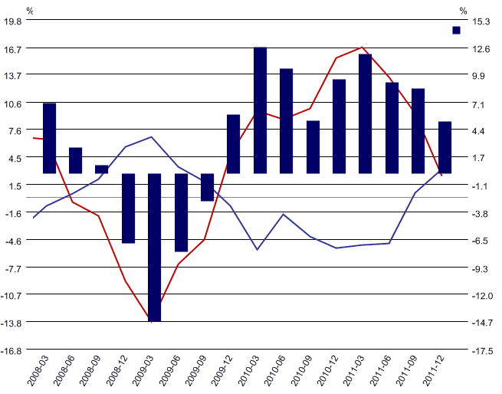
Turkey recovered from the crisis by the increase in domestic demand
Share of demand in GDP
GDP Growth rate
External demand (share in GDP)
Domestic demand (share in GDP)
GDP growth
Source: Turkey Data Monitor

Slide 23
Employment in manufacturing was the worst affected
Changes in employment in each sector
Agriculture
Manufacturing
Services
Source: TÜİK

Slide 24
Trends in unemployment during the crisis
Educational level | 15-24 | 25-34 | 35+ | Total
Primary school and less | 16% | 17% | 24% | 57%
Middle school | 11% | 9% | 6% | 25%
Higher education | 7% | 9% | 3% | 18%
For those between the ages 35-54 the rate of increase of unemployment was the highest
Those who had the highest unemployment share was Primary school graduates or the less educated .
While male unemployment rose, female labor force participation rate increased.
Unemployed according to gender
Female
Male
Source: TÜİK

Slide 25
Government Responses to the crisis…
Employment package:
5% reduction in the social security premiums
11% increase in unemployment benefits,
Increase in incentives paid for the injured and the disabled from the Treasury (50 %)
Debt restructuring for bad cheques, credit cards and other credits
Increased short-time work allowances to prevent job layouts

Slide 26
…were possible with the help of the social dialogue partners!
Temporary tax reductions
Investment incentive programs: corporate tax reductions
Loosening of the the restrictions on the employment of contract labour
Increase in government investment programmes
Active labour market policies

Slide 27
Cost of Government Responses
 | Estimated Fiscal Expenditures (Million TL)
 | 2008 | 2009 | 2010 (estimated) | 2008-2010
Reduction of employers' social security contributions | 17 | 3,726 | 4,327 | 8,070
Expansion of activities on vocational training |  | 152 | 343 | 495
Reduction of social security contributions for young and female workers | 16 | 66 | 137 | 219
Recalculation of unemployment insurance payment in terms of gross instead of net amount | 40 | 119 | 87 | 246
Increase of short-term working allowances by 50 percent |  | 162 | 106 | 268
Social work programs |  | 78 | 151 | 229
Total cost of the measures to stimulate employment | 73 | 4,303 | 5,000 | 9,527
Share in GDP (%) | 0.01 | 0.45 | 0.49
Kaynak: Ercan, Taymaz ve Yeldan (2010) “Kriz ve Türkiye: Kriz Tedbirlerinin Etki Değerlendirmesi”, ILO

Slide 28
Health and education sectors severely affected from the crisis
Severe demand reductions for the private sector companies in both sectors
Reversal of the trend to increase the share of health in total social spending: shares of health and education converged after the 2008 crisis.
Share of education and share of health in total social spending
Source: TurkStat

Slide 29
Three levels of social dialogue in Turkey
Government policies
Union activities
Activities of professional and employers’ unions
Campaigns
National level
Policies specific to sectors
Intra-company aggrements between different companies
Cross-sectoral level
Company level
Restucturing attempts
Agreements with employees:
Cancellation of salary increases
policies and practises to cut expenses

Slide 30
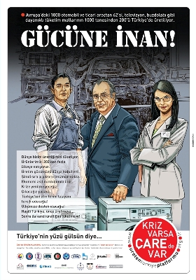
Example of Social dialogue: National level
“There Is a Remedy for the Crisis” – 5-week campaign initiated by TOBB with the participation of many unions and organizations such as TÜRK-İŞ, HAK-İŞ, TESK, TİSK, KAMU-SEN, TİM, TÜSİAD ve MÜSİAD
Each campaign targeted different social groups such as women, workers or employers
Municipalities helped distribute the posters in all cities
Main goal: increasing domestic consumption by stimulating households to spend

Slide 31
Result : Increase in Consumer Confidence
A significant increase in domestic demand and consumer confidence following the start of the campaign in March 2009.
Source: Central Bank of Turkey
The campaign is an example of solidarity that brought together different social partners.
An alternative to the bottleneck experienced in the traditional social dialogue mechanisms with voluntary cooperation of all stakeholders.

Slide 32
Examples of Social Dialogue: Cross-sectoral Level (1)
SKILLS’10 Project: Reducing structural unemployment
Initiated by Turkish Ministry of Employment and Social Security, the Turkish Ministry of National Education, the Union of Chambers and Commodity Exchanges of Turkey (TOBB) and the TOBB University of Economics and Technology.
Unemployed were given six months training:
Theoretical training in the vocational high schools
On-the-job training.
The project helped solve the temporary unemployment problem in the crisis and is a step to solve the structural unemployment problem

Slide 33
Social Dialogue: Cross-sectoral Level (2)
Steelworkers’ union: Collective bargaining in the steel industry in 2009 resulted in a voluntary 35% reduction in wages for 16 months – after that workers’ wage losses were compensated without any reflection on their welfare benefits.
This practice is said to have prevented particularly the bankruptcy of the steel company ISDEMİR, and the shutdown of the company’s factories in Iskenderun.
The reduction in wages provided a very favourable alternative to the 2,000 workers in the industry, for if it was not for the wage reductions these workers would have lost their jobs.

Slide 34
Examples of Social Dialogue: Company Level
Ford Otosan had to locate 410 voluntary employees to Arçelik-LG air conditioner factory (both are joint ventures of Koç Holding with Ford and LG Electronics) in order not to close down the factory
The employees volunteered to work in another factory
Their employment and social security status were not affected from the change.
MESA Hospital: managed to survive the crisis without obtaining loans in order to pay wages, and closed 2009 with a higher profit rate than 2008. No employee was laid off.
Simple cost-saving measures (lightbulbs, elevators etc.)
Close dialogue with workers: established a council from staff to discuss cost reducing measures

Slide 35
Policy responses to social dialogue

Slide 36
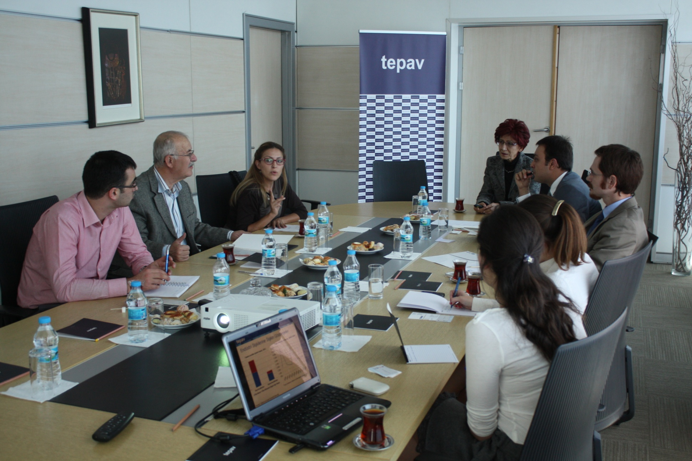
Many trade union confederations attended the national debate in Turkey
TEPAV, 16th October 2012

Slide 37
Impact of Social Dialogue (1)
TOBB’s project “There is a Remedy for the Crisis” has been the most prominent example of social dialogue that
Brings all private sector stakeholders together
Employers’ unions, trade unions and occupational unions
Demonstrates solidarity around the common purpose of recovery from the crisis as a whole
Impact of the campaign: significant increase in domestic demand and consumer confidence

Slide 38
Impact of Social Dialogue (2)
Vocational training through public-private partnership: SKILLS’10
Started as a measure to reduce temporary unemployment
Stakeholders realized it could help solve the structural unemployment problem
Until now;
38 thousand trainees have been trained
20 thousand trainees were employed

Slide 39
Impact of Social Dialogue (3)
The Confederation of Tradesmen and Craftsmen’s (TESK) accomplishments for policy: Preparing the draft for regulations
Restructuring of credit card debt
Restructuring of social security contribution payments
Restructuring of assets transeffered to asset management companies

Slide 40
Impact of Social Dialogue (4)
TÜRK-İŞ contributed several other measures that would protect workers from being laid off due to the global economic crisis:
Provision of a condition on the social security contributions, stating that no worker should be laid off on account of the crisis
Restructuring of debts, drafted by TESK, should include consumer credits and credit card debts
Utilization and increase of unemployment benefits, using the Unemployment Insurance Fund
Protection and improvement of the right to acquire severance payments
Increasing the purchasing power, and therefore domestic demand of public sector employees by granting them the right for collective bargaining.

Slide 41
Conclusion
The traditional social dialogue mechanisms has not been working effectively in Turkey.
The Turkish government was relatively late in responding to the global crisis.
This situation helped social dialogue partners to come together and act collectively
The private sector cooperated in responding to the crisis
Past crisis experiences in Turkey was a significant factor that caused Turkey not to be affected severely from the crisis
If the changes in the new legislation open the channels for social dialogue in Turkey, it will be a very significant step
Such strong dialogue legislation, platforms, and mechanisms would help Turkey minimize the effects of a possible future crisis.

